Slide 1
New Provider Orientation
April 2022

Slide 2
Welcome to Weill Cornell Medicine!
The goal of this orientation deck is to increase your knowledge of Weill Cornell Medicine, learn critical elements of our organization, and provide you with the resources to hit the ground running on your first days of clinical practice.
We hope this information equips you for a long and successful career as part of our team of clinicians delivering high-quality, patient-centered care.
Notes:
A warm welcome and highlights what to expect in this deck
Increase knowledge both about the organization, understand our structure, and familiarize with the tools we use daily & have access to

Slide 3
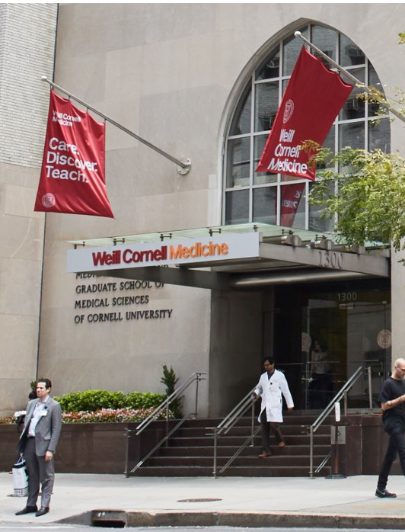
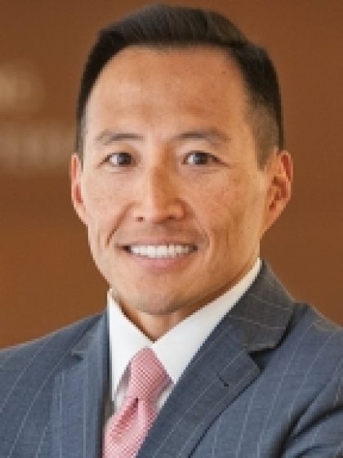
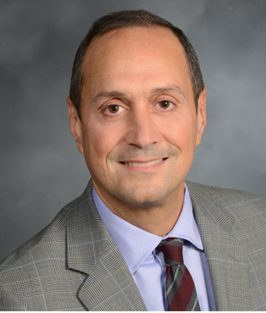
Introduction From Clinical Leadership
On behalf of all faculty, students, and staff, we would like to welcome you to Weill Cornell Medicine’s world-class organization of physicians, researchers, and students. You will play an integral role in furthering our organization’s mission, “Care. Discover. Teach.” Weill Cornell Medicine is committed to excellence in patient care, scientific discovery, and the education of future physicians in New York City and around the world. Since 1898, our doctors and scientists have been engaged in world-class clinical care and cutting-edge research that connect patients to the latest treatment innovations and prevention strategies. In addition, our physicians are committed to providing exemplary care to our community, including but not limited to all five New York City boroughs, the greater tri-state area, and patients from around the world.
Weill Cornell Medicine physicians provide patient care at NewYork-Presbyterian/Weill Cornell Medical Center, NewYork-Presbyterian Westchester Behavioral Health Center, NewYork-Presbyterian Lower Manhattan Hospital, NewYork-Presbyterian Queens, and NewYork-Presbyterian Brooklyn Methodist Hospital. Faculty are appointed with a title at both the Medical College and the hospital.
As an institution, Weill Cornell Medicine recently launched the We’re Changing Medicine fundraising campaign, the largest in our history and the first campaign in decades to advance and synergize all three institutional missions: to care, discover and teach. Exemplifying the Cornell University mission of doing the greatest good, the new campaign will instill this essential value in the next generation of physicians and scientists, who will shape an innovative and equitable future of medicine. Your presence on our campus will serve to advance these goals further.
Joining a new organization with a comprehensive onboarding process can be challenging but know that we're all here to help you succeed as you begin your career journey at Weill Cornell Medicine. This presentation is intended to help inform and guide new providers to help you hit the ground running on your first day of clinical practice. We once again welcome you and share in your excitement as you embark on your career at Weill Cornell Medicine.
Best,
Dr. Robert J. Min,
John A. Evans Professor of Radiology
Chair of Radiology and Radiologist-in-Chief
President of Weill Cornell Imaging at NewYork-Presbyterian
President & CEO of the Weill Cornell Physician Organization
&
Dr. Adam R. Stracher,
Chief Medical Officer and Director of Primary Care, Physician Organization
and Associate Dean, Clinical Affairs
Notes:
A more pointed warm welcome from Dr. Stracher, providing additional context highlighting
The community (and extended community) we serve
Introduces our strong relationship with NYP
Highlights our current We’re Changing Medicine campaign investing in innovation

Slide 4
Care. Discover. Teach.
With a legacy of putting patients first, Weill Cornell Medicine is committed to providing exemplary and individualized clinical care, making groundbreaking biomedical discoveries, and educating generations of exceptional doctors and scientists.
Notes:
Introducing our Mission and our commitment to our patients, students and innovation

Slide 5
Our History
1898: Cornell Medical College is founded
2015: Rebranded to Weill Cornell Medicine to fully embrace mission to Care, Discover, Teach
1913: Cornell Medical College became affiliated with what is now NewYork-Presbyterian Hospital
1932: Two institutions open a joint campus at the current location on the Upper East Side
2001: Establishment of Weill Cornell Medicine-Qatar
1998: Institution renamed in appreciation of a generous donation by Board of Fellows Chair Emeritus Sanford I. Weill
2007: Opening of Weill Greenberg Center, an award-winning ambulatory care and medical education building
2019: Debt-free: Powered by philanthropy, Weill Cornell Medicine eliminates medical education debt for all qualifying students
2021: “We’re Changing Medicine”: the largest campaign in Weill Cornell Medicine’s history, used to harness emerging biomedical innovations to bring exemplary care to patients and create enduring changes in medicine
1771: New York Hospital is founded
Notes:
A high-level view of our institution's history, particularly how far we date back all the way to our rebranding in 2015 (this is 250 years of history through 2021!)

Slide 6
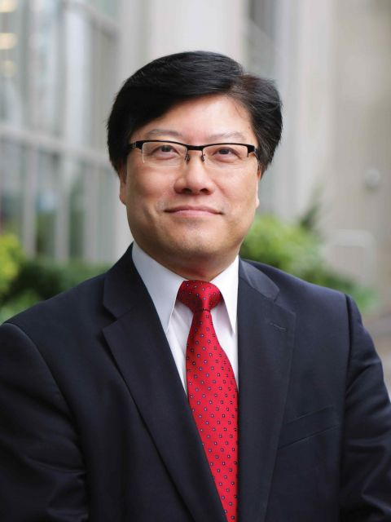
Augustine M.K Choi, MD Stephen and Suzanne Weiss Dean, Weill Cornell Medicine Provost for Medical Affairs, Cornell University
Dr. Choi received a bachelor’s degree in 1980 from the University of Kentucky and an MD in 1984 from the University of Louisville. After completing his internship and residency in internal medicine at Duke University and a fellowship in pulmonary and critical care medicine at Johns Hopkins University, he began his academic career in 1990 in the division of pulmonary and critical care medicine at Johns Hopkins. In 1998, he moved to an appointment at Yale University, and in 2000, he became chief of the division of pulmonary, allergy and critical care medicine at the University of Pittsburgh. In 2007, he was appointed the Parker B. Francis Professor of Medicine at Harvard Medical School and chief of pulmonary and critical care medicine at Brigham and Women’s Hospital. He served as the Sanford I. Weill Chairman and Professor of Medicine in the Joan and Sanford I. Weill Department of Medicine at Weill Cornell Medicine and as physician-in-chief of NewYork-Presbyterian/Weill Cornell Medical Center, prior to his appointment as dean in January 2017.
Source: https://weill.cornell.edu/our-story/leadership/augustine-choi
Notes:
A spotlight on Dean Choi and his biography from our website

Slide 7
Mission, Vision & Values
Care: Forward-thinking, compassionate, high quality patient care is the heart and soul of our mission.
2021-2022
2.81 million annual patient encounters
1,718 physicians
419 top doctors*
166 sites throughout New York, with offices in Manhattan, Queens, Brooklyn, Westchester, and Eastern Long Island**
95.9% Press Ganey patient satisfaction score***
For a comprehensive list of our clinical services offered, please visit https://weillcornell.org/services.
*As ranked by Castle Connolly
**Includes satellite locations
***Overall patient satisfaction with provider
Notes:
More detail on our mission, vision & values – high level data points related to our patient care

Slide 8
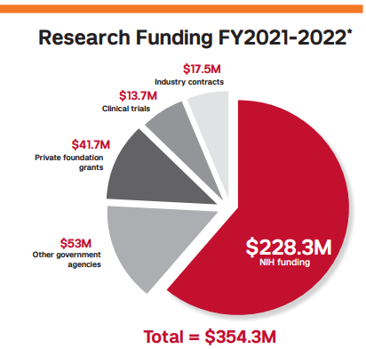
Mission, Vision & Values
Discover: Patient-focused, groundbreaking research conducted by faculty & graduate students. Weill Cornell Medicine has built an extensive research infrastructure, recruited esteemed investigators, and secured substantial resources toward finding better treatments for medical diseases.
1,071 National Institutes of Health awards
3 new start-up companies
395 active U.S. patents
912 active clinical trials
4,013 published peer-reviewed journal articles
510,000+ square feet of research space
Notes:
High level data points for our research accomplishments and capabilities

Slide 9
Mission, Vision & Values
Discover: Some notable research breakthroughs and current initiatives at Weill Cornell Medicine:
1943: Dr. George Papanicolaou & Dr. Harold Trout develop the pap smear test for cervical cancer
1954: Drs. Frank Glenn and Joseph Artusio develop ether analgesia, which allows a patient to be conscious without feeling any pain or memory of the surgery
1955: Dr. Vincent du Vigneaud, Chairman of the Department of Biochemistry, receives the Nobel Prize in Chemistry for his research on the pituitary gland hormone oxytocin, crucial for childbirth and producing milk. Dr. Vigneaud is also known for accomplishing the first synthesization of penicillin in 1946
1983 to 1991: AIDS biomedical research began in 1983. The Center for Special Studies and AIDS Clinical Trials, directed by Dr. Jonathan Jacobs, is established in 1986. In 1991, a new facility on the 24th Floor of the Baker Tower was opened
1993: Dr. Ronald Crystal, Chief of the Pulmonary and Critical Care Medicine Division, is the first to use a genetically altered cold virus to treat cystic fibrosis
2007: Published Nature study, led by Dr. Nicholas Schiff, demonstrates the power of deep brain stimulation to improve the outcomes of patients with severe brain injury
2014: Opening of the Belfer Research Building, a state-of-the-art 480,000 square-foot facility focused on facilitating cutting-edge research
2021-: Precision Health: A key part of our “We’re Changing Medicine” campaign, WCM will create a robust precision health enterprise that will holistically evaluate the individual factors that underlie disease development
2021-: Weill Cornell Medicine receives two large, prestigious NIH grants to engage in HIV Cure research
REACH: Martin Delaney Collaboratory grant awarded to lead principal investigator Dr. Brad Jones
HOPE: Martin Delaney Collaboratory grant, involving co-principal investigator Dr. Lishomwa Ndhlovu, in collaboration with Cornell’s Ithaca campus
For a comprehensive list of research achievements and awards at Weill Cornell Medicine, please visit https://research.weill.cornell.edu/about-us/achievements
Notes:
Notable research breakthroughs, once again reiterating our accomplishments and more to be proud of

Slide 10
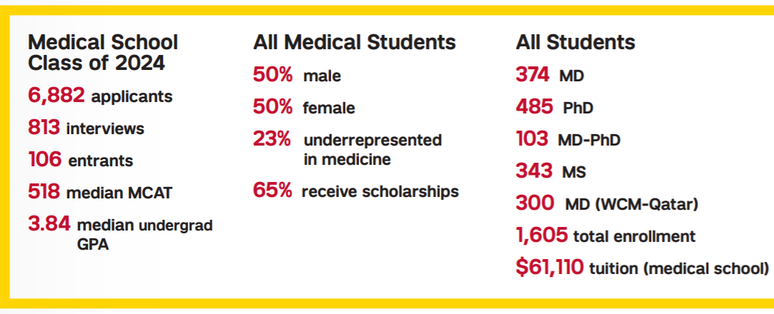
Mission, Vision & Values
Teach: Weill Cornell Medicine is consistently ranked among the nation’s top medical and graduate schools, educating the world’s future healthcare leaders.
The Graduate School of Medical Sciences is committed to providing advanced training in microbiology, biophysics, and biochemistry. It leverages mutually beneficial partnerships with its neighboring institutions through programs that capitalized on each of their various strengths, such as the Gerstner Sloan Kettering Graduate School of Biomedical Sciences and the Tri-Institutional MD-PhD program with The Rockefeller University.
2021-2022 Faculty & Staff
6,513 clinical faculty
394 basic science faculty
5,521 staff
374 based in WCM-Qatar
Notes:
High level statistics shedding light on our clinical faculty, information about our graduate school of science, etc. all can be found on our fact sheets that are updated and distributed annually by External Affairs. This will be updated annually as it becomes available.

Slide 11
Site Locations
Aside from our primary campus on the Upper East Side, Weill Cornell Medicine’s locations span Manhattan, Brooklyn, and Queens, Westchester County, and Southampton.
Notes:
A site location map to show our reach throughout the boroughs, Westchester and Southampton to come. Up north, we have an ENT location in Chappaqua (300 encounters) and a CRMI practice (4000 encounters) in Mt. Kisco (FY21)

Slide 12
Weill Cornell Medicine & NewYork-Presbyterian

Slide 13
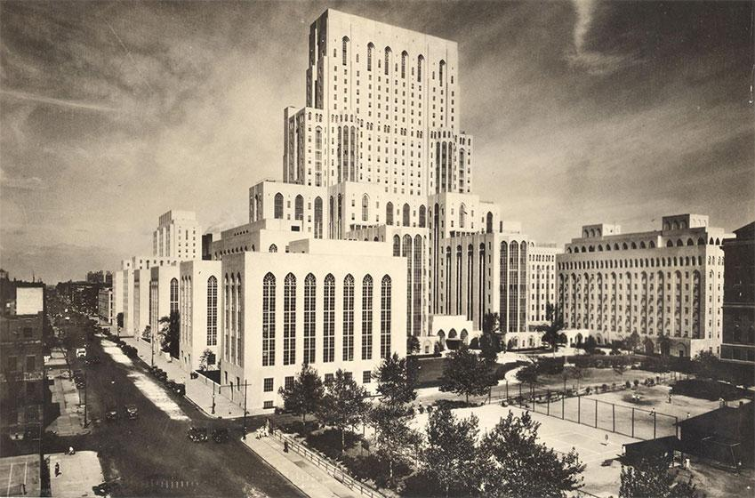
Weill Cornell Medicine & NewYork-Presbyterian
Weill Cornell Medicine’s partnership with NewYork-Presbyterian dates to 1932
Faculty from WCM are also attending physicians at other affiliates: NYP Hospital/Weill Cornell Medical Center, NYP/Lower Manhattan Hospital, NYP/Queens, and NYP/Brooklyn Methodist
Though the two organizations are closely tied, they are separate institutions with different administrative and financial leadership, employee policies, and HR departments
The NewYork-Presbyterian Hospital/Weill Cornell Medical Center, courtesy of WCM Samuel J. Wood Library
Notes:
Introducing the historical partnership between the two institutions, while reiterating we are two separate institutions with different leadership, policies, etc.

Slide 14
Weill Cornell Medicine & NewYork-Presbyterian Clinical Awards & Accolades
Weill Cornell Medicine is honored & privileged to be partnered with such a decorated hospital.
This is the 21st consecutive year that NewYork-Presbyterian Hospital is the top-ranked hospital in New York.
Ranked #7 in U.S. News Best Hospitals Honor Roll, 2021-2022, recognizing national excellence in multiple specialties.
Source: https://health.usnews.com/best-hospitals/area/ny/new-york-presbyterian-university-hospital-of-columbia-and-cornell-6210024
Notes:
Here we highlight NYPs clinical awards and accolades, which helps to illustrate the value and appreciation we have in our affiliation.

Slide 15
Physician Organization & Leadership
The WCM Physician Organization serves as the Medical College’s management arm assuring excellence in the day-to-day practice of medicine in an academic setting. The Physician Organization (PO) is a self-governing entity of the Medical College.
The Physician Organization establishes, operates and oversees the necessary infrastructure enabling Weill Cornell physicians to practice medicine with the most effective and efficient management tools available.

Slide 16
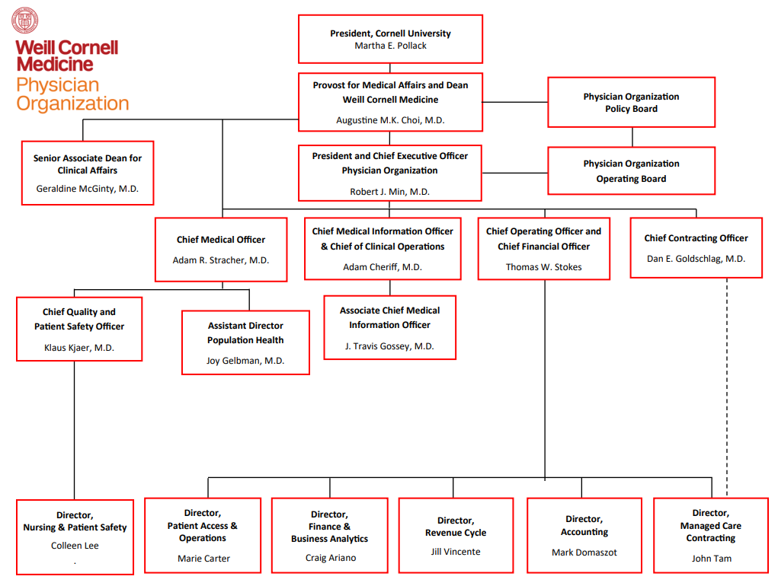
PO Leadership Organizational Chart

Slide 17
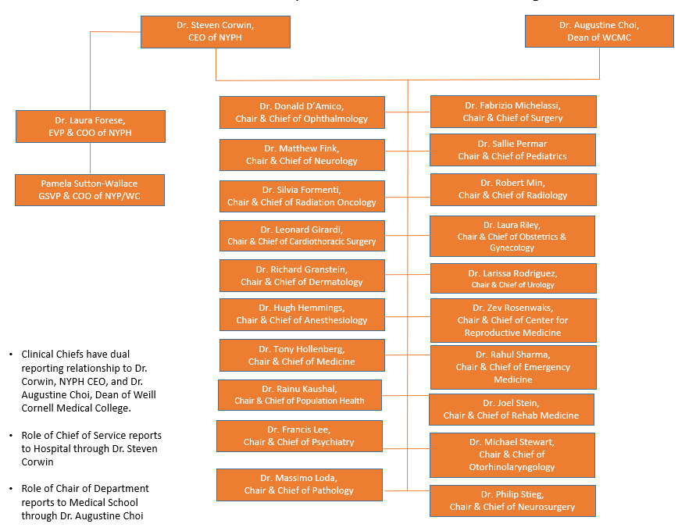
NewYork-Presbyterian/Weill Cornell Medical Center Clinical Chiefs Table of Organization
Clinical Chiefs have dual reporting relationship to Dr. Steven Corwin, NewYork-Presbyterian Hospital CEO, and Dr. Augustine Choi, Dean of Weill Cornell Medical College
Role of Chief of Service reports to Hospital through Dr. Steven Corwin
Role of Chair of Department reports to Medical School through Dr. Augustine Choi
Notes:
To further connect to the previous slides, this shows how our clinical chairs and chiefs report to both the dean of WCMC and the CEO of NYP.

Slide 18
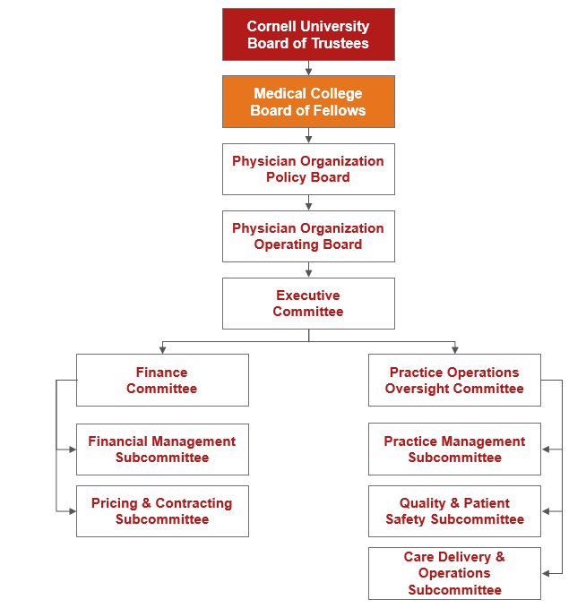
Physician Organization Committee Structure
Notes:
Policies & procedures can go through this process

Slide 19
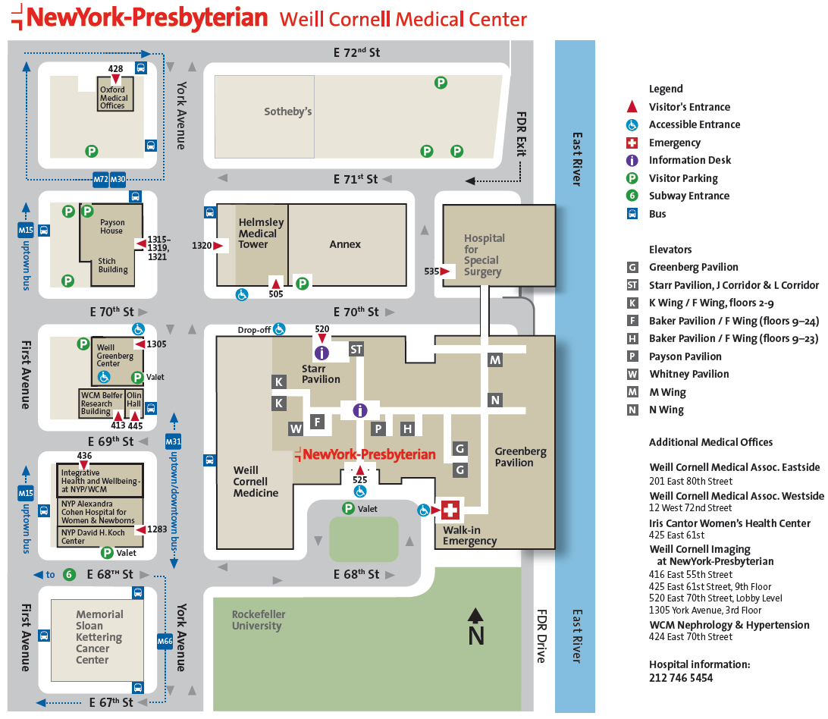
Key Buildings
Notes:
This may need to be scrapped, though it is helpful it is outdated. It’s been difficult tracking down an updated version of this from NYP but I will continue to poke around.

Slide 20
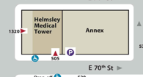
Your Weill Cornell Medicine Badge
All employees are required to display their Weill Cornell Medicine photo identification badge while on-premises. The card contains a photograph of the employee, job title, and department as appropriate. Identification cards are distributed to new employees during orientation, which is the first day of work.
The card must be:
Visible for everyone to read
Presented upon request
Worn upon entering and exiting the medical complex
Employees should visit Security at:
NewYork-Presbyterian/Weill Cornell Medical Center: Annex-139, located on 70th street, east of York Avenue, just after the Helmsley Medical Tower
Notes:
Important notes about our badge policy, and where one can go to retrieve it or replace it.

Slide 21
Your CWID
wcm1898@med.cornell.edu
Center-Wide Identity (CWID)
Pronounced: Seaweed
CWID: wcm1898
E-Mail Address: wcm1898@med.cornell.edu
Your CWID is your username and login for all major applications, including but not limited to Epic, Outlook, WCM tagged devices, and to log into the NYP Infonet

Slide 22
Activating Your CWID
You can activate your CWID on your phone or wherever you have computer access
Go to: https://identity.weill.cornell.edu/activate
Enter your CWID and personal email address on file
Once verified you will receive a temporary password to the email address on file
You can also visit https://identity.weill.cornell.edu/ to change or reset your password
Once activated, you will need to wait up to two hours before you can access WCM systems
If you need help or computer access, go to the SmartDesk located in the Samuel J Wood Library, 1300 York Avenue, or call 212-746-4878 (Mon. - Fri. 7 AM - 7 PM)
Notes:
A common issue, information on where a new physician can go to activate their CWID, and change password if necessary.

Slide 23
Epic (EMR)
Epic is a sophisticated application designed to perform most workflows for our practices to provide patient care in the outpatient setting, including registration, scheduling, visit documentation, and billing. It also provides a method for departments to release information to appropriate external entities and provide our patients with more access to their healthcare information.
In 2017, Weill Cornell Medicine, NewYork-Presbyterian and Columbia announced the signing of a joint contract intended to create a single electronic health record system across our three institutions, called EpicTogether. This collaboration will make it easier and more efficient for our physicians and other clinical staff to deliver outstanding patient care. As of 2021, all locations are live and operational on Epic.
Notes:
Background on Epic for those that are unfamiliar, as well as information regarding EpicTogether and its benefits (one system, care coordination, overall improvement in care delivery), with the expected timeline and completion in a few months.

Slide 24
Epic Training
To gain access to Epic, users must complete training relevant to their roles. Your department designee will assign you the appropriate ambulatory training to ensure you can access the tools needed for patient care. Your specific Epic training depends on your role and specialty.
Once you are enrolled in training, you will receive an e-mail with the details and information on accessing the links. Upon successful completion, you will be granted access to the Epic application.
There are several tip sheets in our EpicTogetherNY.org catalog for quick reference. In addition, we encourage peers to share their knowledge of Epic tools with new colleagues to increase efficiency, including the use of SmartTexts, SmartPhrases, SmartLists, and other SmartTools.
Notes:
Epic Training is of utmost importance when joining, as without it you are not granted access. This is handled as part of the onboarding process, but provides insight into the process, while introducing the tip sheet catalog and SmartTools to help drive provider efficiency

Slide 25
Provider eCOMPetency
The Clinical Operations Subcommittee developed Weill Cornell’s eCOMPetency report to measure EHR system proficiency to help improve patient care via communication, integration, and collaboration. Each metric has been designed to provide objective data about adherence to most of our approved EHR usage standards, regulatory requirements, or established quality metrics. The eCOMP report is scored on a scale of 0-100%; all ten metrics add up to a total score compared to the overall PO average. These reports are distributed on a quarterly basis.
It is important to emphasize that these measures are imperfect and will likely require some revision over time. However, the committee believes that the concepts represent the minimum that we should strive for to become a more integrated, higher-value health system. The reports will reveal some deficiencies in ideal behaviors and many areas of artifact that will require workflow redesign or further analysis.
For more information regarding the eCOMPetency metrics, including job aids, please click here
Ten Measured Metrics:
Face-to-Face Encounter Closure
Telephone Encounter Closure
In-Basket Use
MyChart Message Response Time
Medication Reconciliation
Allergy Documentation
Tobacco Use Documentation
Problem List Documentation
ePrescription Rate*
Weill Cornell Connect Enrollment Rate
*Effective March 27, 2016, Practitioners are mandated to electronically prescribe both controlled and non-controlled substances effective March 27, 2016. However, there are several exceptions in which a practitioner may issue an Official New York State prescription (ONYSRx) form, oral prescription or a fax of an ONYSRx
Notes:
Information about our eCOMPetency report and the associated measured metrics, and what it tells us about our processes. The Ecomp reporting guide is also linked, which has some job aids associated with the measured metric workflows.

Slide 26
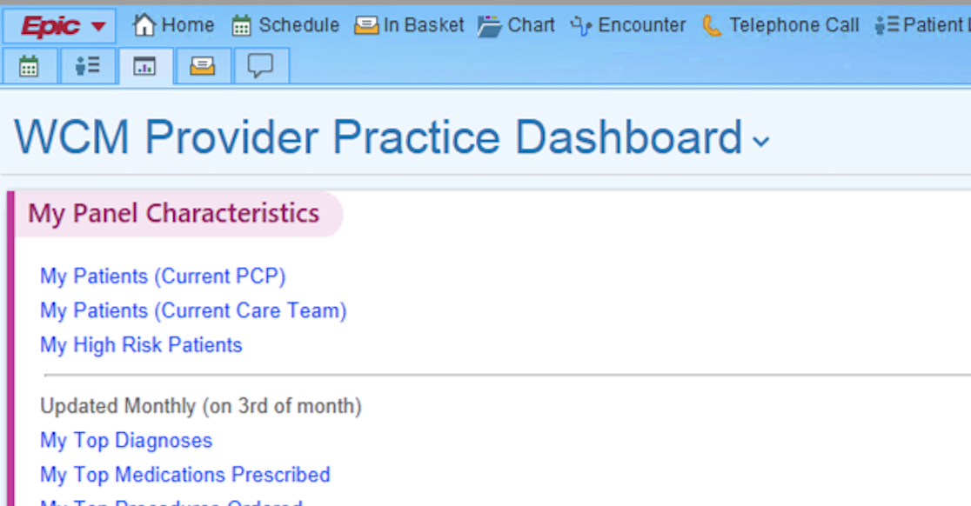
Provider Dashboard
The Physician Practice Dashboard in Epic provides a convenient, centralized overview of your patient panel and practice patterns. From the dashboard, you can navigate to other dashboards with more detailed information, reports that identify and characterize patients represented on the dashboard, or even directly to a patient’s chart to place an order or send a Weill Cornell Connect message. This tool is designed to empower physicians to have more insight into their patients and how they practice.
You can access the dashboard by clicking on the tab that looks like a graph, as seen here:
Notes:
Introduces the provider dashboard, which empowers providers to gain insight into their patients, how they practice, their productivity, and much more.

Slide 27
Weill Cornell Connect
Weill Cornell Connect is an essential tool in our suite of digital health services that serves as our patient portal. Patients leveraging Connect can accomplish a variety of things aimed at enhancing the patient experience. It provides patients with secure, convenient access to their healthcare.
Through Weill Cornell Connect, you have access to:
Telehealth services, including Follow-up Video Visits, eCheck-In and urgent care on demand
Test results
Online appointments
Online bill payment
Simpler, streamlined communication with your provider’s office
A record of all appointments, emergency room visits, and inpatient stays
After-visit summaries
For more information on Weill Cornell Connect, visit https://weillcornell.org/weill-cornell-connect
Notes:
High level information about WCC – for which many of our initiatives depend on high enrollment (e-check in, fast pass, telehealth services, online scheduling, and more).

Slide 28
Quality & Patient Safety: A Culture of Safety & Respect
The Division of Quality and Patient Safety’s mission is to lead and support Weill Cornell Medicine physician-led initiatives focused on quality, patient safety, and risk management. Our vision is to promote the mission, vision, and values of Weill Cornell Medicine by enhancing patient safety, reducing the potential of healthcare errors, mitigating risk for patients, and establishing a reliable, safe healthcare environment.
Key initiatives under QPS:
SafetyZone: a centralized, secure event reporting system used to manage adverse events, near misses, and unsafe conditions. The events are then analyzed by QPS staff and used to help create tools for quality improvement.
KeepSAFE: the reporting system for adverse events, near misses and unsafe conditions, like SafetyZone, used at NYP locations only
Patient Safety Program: a two-requirement program developed to help mitigate the increase in malpractice premiums for physicians. For more information about the program’s requirements, please visit: https://qps.weill.cornell.edu/node/247 (CWID and password required)
Provider Well-Being Assessments: a brief, 100% anonymous, online self-assessment tool developed by the Mayo Clinic to measure wellness and predictors of burnout among healthcare professionals. Completion of the Well Being Index offers immediate, individualized feedback, access to resources, and the ability to track your well-being over time. Weill Cornell Medicine’s version includes two process improvement questions that will allow you to provide direct feedback to WCM leadership.
For more information about Weill Cornell Medicine’s Quality & Patient Safety division, including policies, procedures, our patient safety program, incident reporting processes, and committee meetings, please visit qps.weill.cornell.edu/.
Notes:
This slide introduces our Quality and Patient safety team, and the work they have done to establish a culture of safety for both patients & providers. A call out here very relevant to providers is the provider well being index, addressing issues like burnout and general dissatisfaction.

Slide 29
Cultivating Your Practice & Clinical Profile
There are several best practices one can follow to help build their clinical practice at Weill Cornell Medicine:
Complete your POPS profile.
“POPS”, the acronym for our Physician Organization Profile System, is a comprehensive directory of all clinical physicians at Weill Cornell Medicine, including a professional headshot, specialties & expertise, credentials, accepted insurances, biography, and more.
A detailed profile increases the chance you will be found in search results by physicians & prospective patients
Edit your POPS profile at: pops.weillcornell.org
Leverage the weillcornell.org “Find a Physician” search powered by POPS to identify the best physicians to refer to at Weill Cornell Medicine
Seek out opportunities to network with other doctors to build referral relationships.
Encourage patients to use Weill Cornell Connect for Rx refills, eCheck-in, messaging, video visits, and more. Patients find Connect convenient – the more they use it, the more likely they will stay with the organization and provide positive word-of-mouth.
Visit the Brand Center at brand.med.cornell.edu for brand guidelines, approved signatures, business card templates, and more.
Work through your CAO or DA to explore additional marketing opportunities.
Reach out to Community Relations teams to explore participation in community engagement opportunities:
Sara Stammer, Government & Community Relations Associate, External Affairs, sas2908@med.cornell.edu
Andréa Bland, Manager, Community Affairs at NYP, adb9047@nyp.org
Notes:
For new providers, developing your practice is hard, but with the right tools, particularly leveraging our POPS capabilities, referral relationships and general awareness can be built. Coupled with the new physician newsletters, building out a detailed profile with a headshot, specialties and expertise can help stimulate referrals and access for patients and hopefully reduce outmigration.

Slide 30
Media Policies & The Office of External Affairs
The office of External Affairs provides strategic communications counsel to faculty, staff and students with the goal of maintaining and further enhancing the reputation of Weill Cornell Medicine.
External Affairs is charged with overseeing engagement with the press and other media. This team protects confidential information and patient privacy and promotes compliance of WCM policies while preserving academic freedom.
Physicians – both current faculty and new hires – should review and comply with Weill Cornell Medicine’s media & social media policies.
Media Policy: http://news.weill.cornell.edu/press-room/for-faculty-staff-and-students
Contact pr@med.cornell.edu to discuss all media requests received, plus any questions regarding media policies
Social Media Policy: http://news.weill.cornell.edu/social-media
Contact socialmedia-wcmc@med.cornell.edu for questions regarding the social media policy, accounts, or other related topics.
Notes:
Along with marketing tools provided by PO Marketing, the office of EA has policies all physicians should be aware of;
The media policy covers strategic communications, particularly with press/media dealings
The social media policy addresses guidelines regarding establishing unit-specific media account and our general social media guidelines.

Slide 31
Referrals: Policy & Strategy
The Physician Organization Referral Management Policy states that members of the Physician Organization will utilize the Epic referral functionality for all internal and external referrals. This process allows for optimal tracking, patient contact, and conversion to appointments by PO practice staff, with the goal of a seamless order-to-appointment experience. Other benefits of Epic referrals include:
Easier for physicians to follow a patient through all aspects of care – such as scans, labs, and consult notes – all integrated into Epic
More convenient for patients – the referral receiving office will contact the patient within two business days to schedule their appointment
Reduced hassle– No need for you or your patients to call around town to find an appointment
Patient retention – greater patient satisfaction, plus the likelihood they will return for follow-up care
The Physician Organization has also developed a functionality within Epic for urgent referrals to ensure patients with the most pressing needs are seen promptly. Using the secure chat tool, referring departments can connect directly with specialty departments for a warm hand-off of a patient to be seen within three days.
For more information, including job aids and participating departments, please visit: https://practiceops.weillcornell.org/how-to/urgent-referral-chat-pools
Notes:
Understanding that new policy is close to being finalized and will be updated here once available.
This slide introduces our policy – which will not change – that members of the PO will place all referral orders through Epic. This ties into our other referral initiatives, why this workflow is beneficial, and a special call out to our urgent referral chat pool functionality being rolled out, ensuring our most pressing patients are being scheduled promptly.

Slide 32
High Level Referral Workflow & Expectations
General workflow:
Referring physician places referral using Epic Orders function, categorized with appropriate prioritization, diagnosis, and reason or referral
You can specify provider and/or specialty within referred to department (optional)
Referral lands in appropriate referral work queue, to be scheduled by referred-to department staff
Referred-to department reaches out to patient to schedule within two days
Closing of the loop to referring provider for urgent referrals
For a job aid detailing the provider workflow for referral ordering, please visit https://practiceops.weillcornell.org/how-to/tip-sheet-provider-referral-workflow
Notes:
The referral workflow and specific call outs, as well as the tip sheets for providers placing referrals in Epic.
This also outlines the expectations for the referral-receiving department to schedule & convert referrals to appointments.
Closing of the loop to referring provider* (part of optimization project – Urgent referrals only, for now) – We would like to work into our workflows, particularly for urgent referrals, a loop closure so the referring doctor knows their patient was addressed. Doing this for all referrals may clog up inbaskets and be a dissatisfier for physicians.

Slide 33
E-Consults
The E‐Consult functionality aims to formalize “curbside consults” through Epic. These can:
Help referring providers with questions about the next steps in the workup or determine whether something needs a formal consultation with a specialist
Allow more accessibility to a specialist’s expertise, helping you tap into the knowledge of an expert when you have a patient‐specific question that you need to be answered, but you don’t think that they need to have a complete visit with a specialist in-office
How E-Consults Work:
Ordering providers will place a “Referral to WCM E‐Consult” order to the appropriate specialty. The E‐Consult Referral order will be routed to an In‐Basket Pool in the specialty practice visible as a message in the “E‐Consult” In Basket folder.
The specialty provider taking charge of the “Referral to WCM E‐Consult” folder will generate an “E‐Consult” encounter from the message. Once the appropriate documentation has been completed, the specialist will sign the E‐Consult encounter and send it back to the ordering provider.
The expectation is that E‐Consults be reviewed, documented, signed, and sent back by the specialty provider within 48 hours of receiving them.
Participating providers are compensated $60 for each completed E-Consult, payable the month after it is completed.
For additional information or questions about these tools, please reach out to Andrew Feigelman in Practice Operations, and visit https://practiceops.weillcornell.org/how-to/e-consults for job aids and participating clinical departments. Please consider, any provider can send an E-Consult request, but please review the current clinical departments participating in the program.
Notes:
Promoting our E-Consults initiative, which, since 1/2020, has been a valuable tool for physicians who are looking for formalized guidance from specialists. Feedback about this tool has been generally positive, helping to avoid unnecessary visits while reimbursing colleagues for their time.

Slide 34
Information Technology & Services (ITS)
ITS partners with our faculty to provide an array of technologies that assist with administration and instruction. While our website offers information on all our available services, this page narrows down those that are most used by our faculty. ITS is here to guide you should you have any questions. Some common services that ITS can assist with:
Hardware/Software issues
Tagging devices
Remote access tools
File sharing & file storage
Job Aids, training guides
New to WCM?
Our ITS Liaisons can provide guidance on IT services to ensure your technology needs are being met. The team will arrange a one-on-one meeting with you to discuss our services and assist in getting you up and running. Once a CWID is created and start date is identified, liaisons reach out to the clinical department to set up introductory meetings with new faculty.
Resources
Our faculty brochures offer an overview of the services you’re eligible to access:
Faculty Brochure
Voluntary Faculty Brochure
Emeritus Faculty Flyer
For more information on the suite of services provided, visit the ITS website at https://its.weill.cornell.edu/
Notes:
ITS liaisons are assigned to cover specific departments. They reach out to new faculty to set up 1-1 meetings to go over the services they provide, go through the faculty brochure, and help with any needs. For reference, data I was provided in FY21 – 40% of new faculty had 1:1 meetings with ITS liaisons. Hopefully that number will go up with it being reiterated here.

Slide 35
Compliance & Privacy
The Privacy Office ensures Weill Cornell Medicine complies with state and federal privacy standards, such as HIPAA. In addition, the office protects the confidentiality and integrity of sensitive information generated and distributed throughout the institution.
The Compliance Office serves as a subject matter resource responsible for promoting institutional compliance program effectiveness and effective risk-based management. The Compliance Office strives to create a culture that supports a collaborative, risk-based decision approach to providing guidance and practical solutions to real-time regulatory challenges.
All WCM workforce members are required to complete new hire and annual compliance and privacy training. Training is based on your role and job-related duties, including:
Annual Hospital Training (via Weill Business Gateway – wbg.weill.cornell.edu)
Conflict of Interest Training (via Weill Business Gateway – wbg.weill.cornell.edu)
PATH (General Compliance & Physician at Teaching Hospital) Training
To request access, contact compliance-training@med.cornell.edu
https://compliance.weill.cornell.edu/
Notes:
Bringing awareness to our compliance & privacy teams who work hand in hand with physicians in many cases. For onboarding, all physicians must complete these 3 trainings either before they start or on an annual basis,

Slide 36
Office of Institutional Equity
The Office of Institutional Equity works closely with stakeholders in the Office of Diversity and Inclusion, Office of Faculty, Human Resources, University Counsel, and the Cornell Center for Health Equity. This cohort is responsible for all investigations into claims of discrimination/harassment and helps develop, coordinate, and operationalize institutional programs designed to advance equity, inclusion, respect, trust, and excellence at Weill Cornell Medicine.
The Office of Institutional Equity collaborates internally and externally to best leverage its resources to support all faculty, staff, and students at WCM by:
Creating a consistent framework for conducting investigations of faculty, staff, student, and trainee reports of discrimination, harassment, and bias at WCM, including Title IX, Title VII, and others
Developing and delivering training programs, consultations, and other learning opportunities to combat bias and harassment in the WCM community
Providing institutional consistency and oversight to ensure equitable hiring, promotion, and pay practices, working with Human Resources, academic search committees, the Office of Faculty, and individual departments
Fostering institutional and department-based inclusion and engagement with workshops, counseling, and programming.
Overseeing staff initiatives designed to promote a culture of inclusion, encourage performance excellence, and collaborate with community programs in New York City.
For more information about the Office of Institutional Equity including collaborators at WCM, the incident reporting process/portal, training and education programs, and the commitment to staff equity and belonging, visit: https://equity.weill.cornell.edu/

Slide 37
Patient Access & Operations
The Patient Access & Operations group partners with clinical departments to help provide patients with the best possible visit, at convenient times and with efficient processes. We strive to ensure that every patient is treated with empathy, respect, and dignity. The group’s many process improvement projects are always tied to our core mission: to improve access, develop and hone operational effectiveness across the Physician Organization, and enhance the quality of the patient experience.
Recent and ongoing projects/services under the Practice Access & Operations group:
Enabling online scheduling through our website and patient portal for several specialties & providers
Template optimization efforts to enhance patient access
Monthly hosting of the Practice Solutions Leadership Forum, a gathering of operational and administrative leads across our clinical departments to identify best practices, share opportunities for standardization, operational solutions, and communicate key updates to practices
Referral Optimization to ensure continuity and coordination of care for all patients
Front Door to Care, a joint initiative with NewYork Presbyterian and Columbia to standardize the patient care experience
For more information, including How-To guides, operational policies and more, visit https://practiceops.weillcornell.org/
Notes:
Highlighting the key organization wide initiatives that aim to improve access, convenience, which also ultimately tie into our mission.

